Slide 1
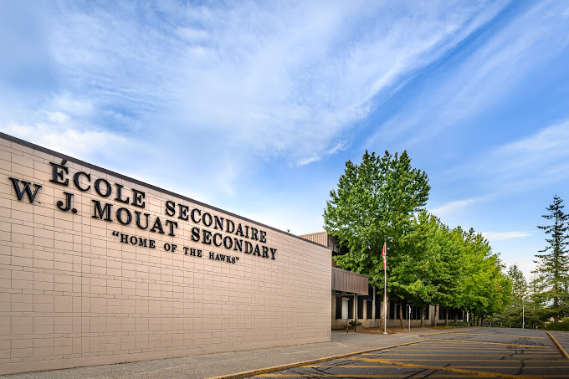
Welcome to WJ Mouat Secondary!
Bienvenu à l’école Secondaire WJ Mouat

Slide 3
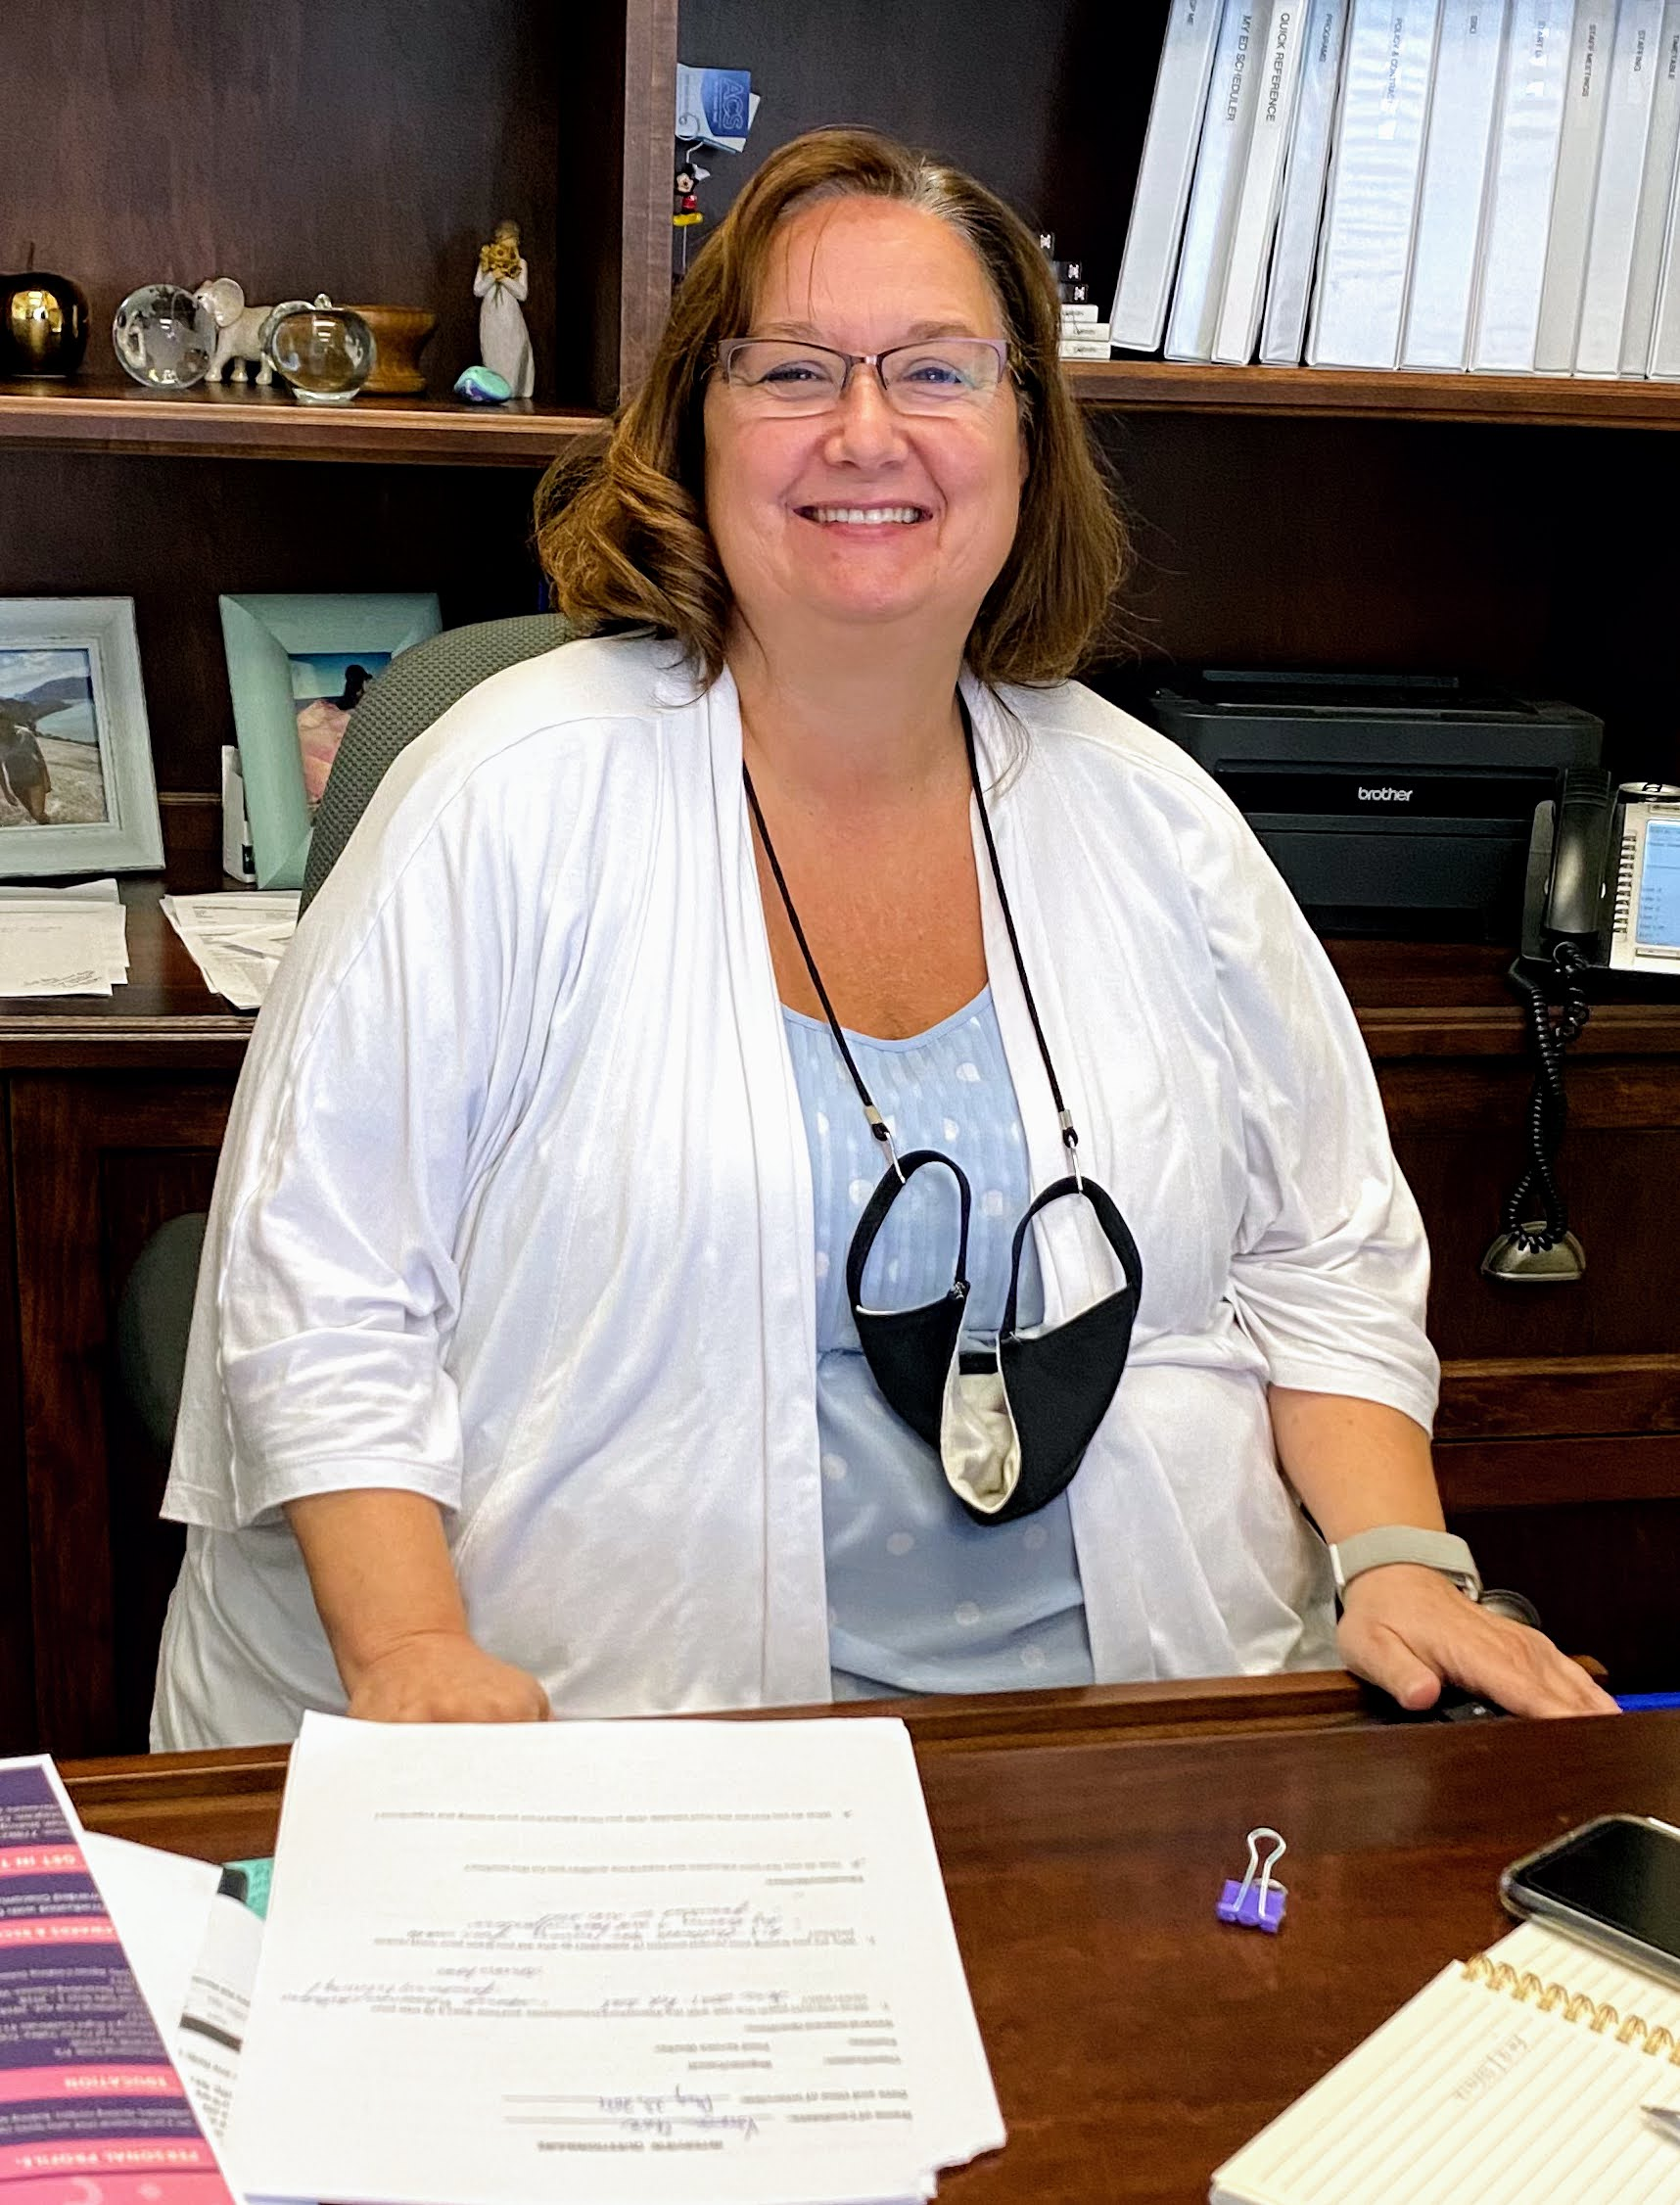
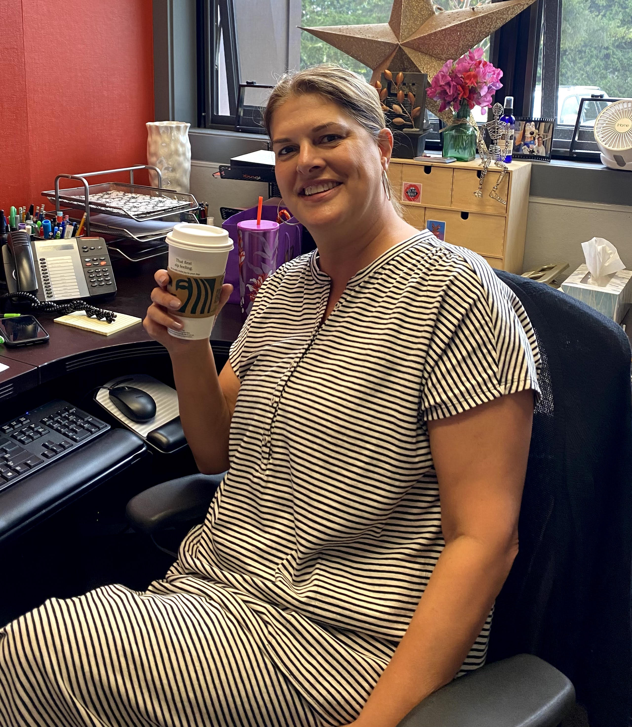
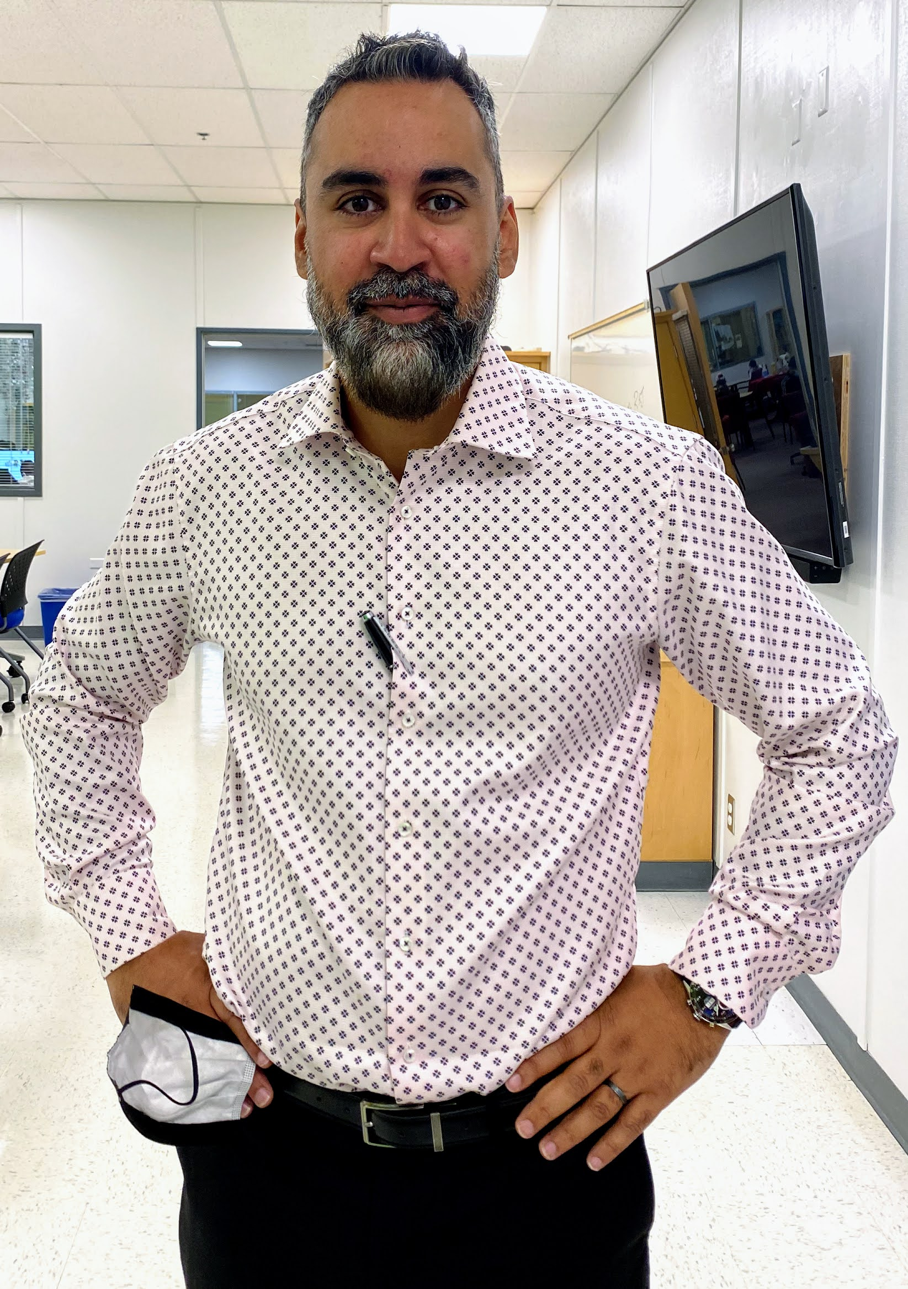
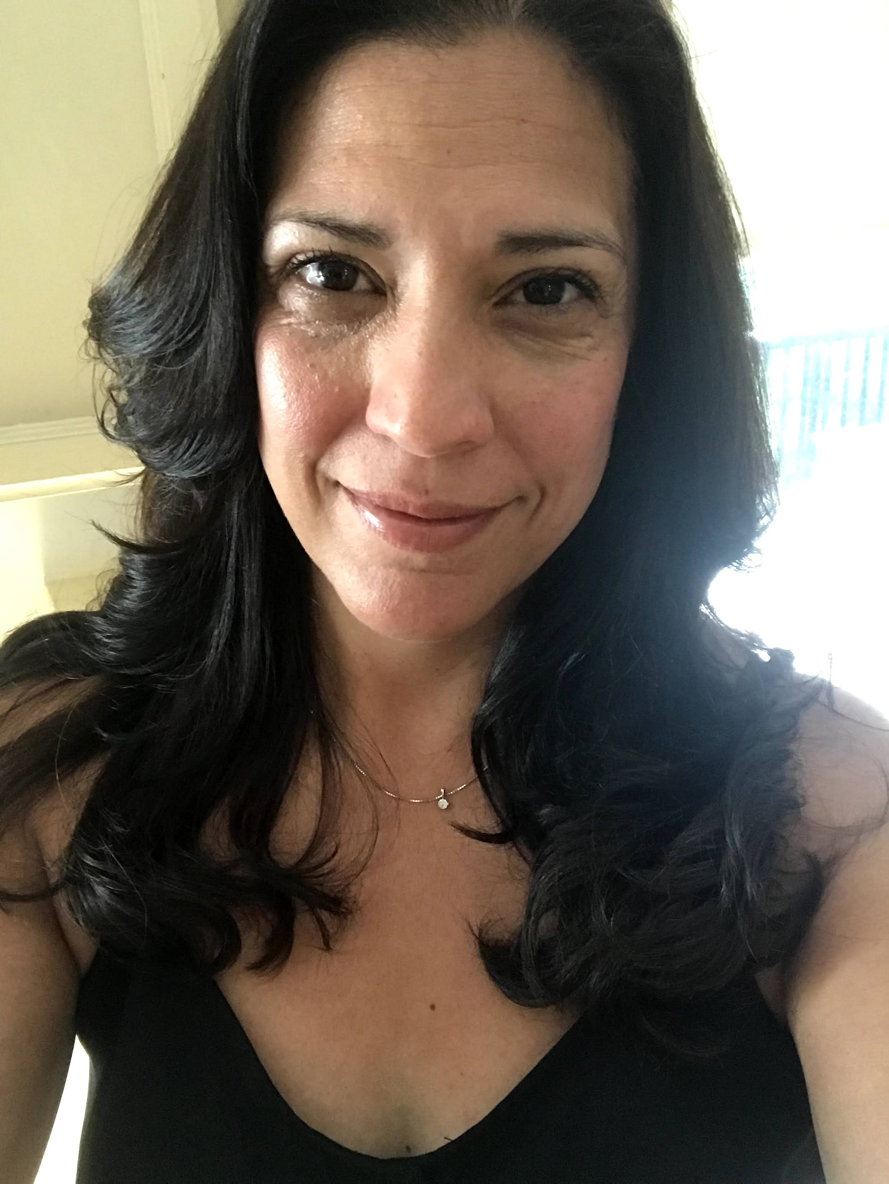
Introductions
Linda Pollastretti- Principal
Paula Thompson- Acting Vice Principal (last name A-F)
Baljeet Gill- Vice Principal (last name G-N)
Soraya Rajabally- Vice Principal (last name O-Z)

Slide 4
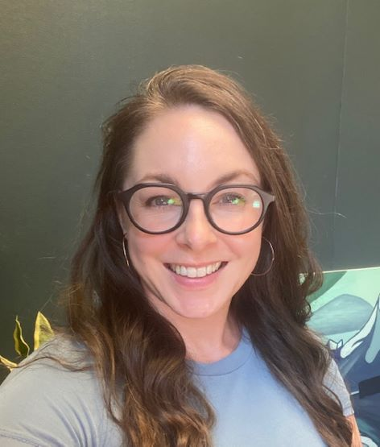
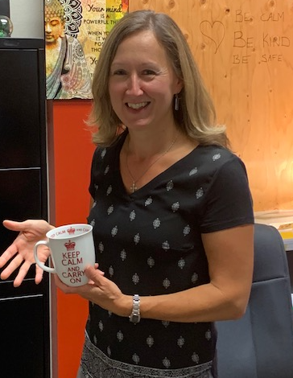
Introductions
COUNSELLORS
Paula Thompson (last name A-F)
Lindsay McAleese (last name G-N)
Michelle Nyberg (last name O-Z)

Slide 5
Middle School vs Highschool
Increasing freedom and responsibility
Freedom to leave campus at lunch
Starting to choose some courses
Classes can be more challenging and demanding
Semester System: More teachers, faster pace
THIS PRESENTATION IS TO SHARE WITH YOU WHAT TO EXPECT MOVING FORWARD AS A GRADE 9 STUDENT AT MOUAT.

Slide 6
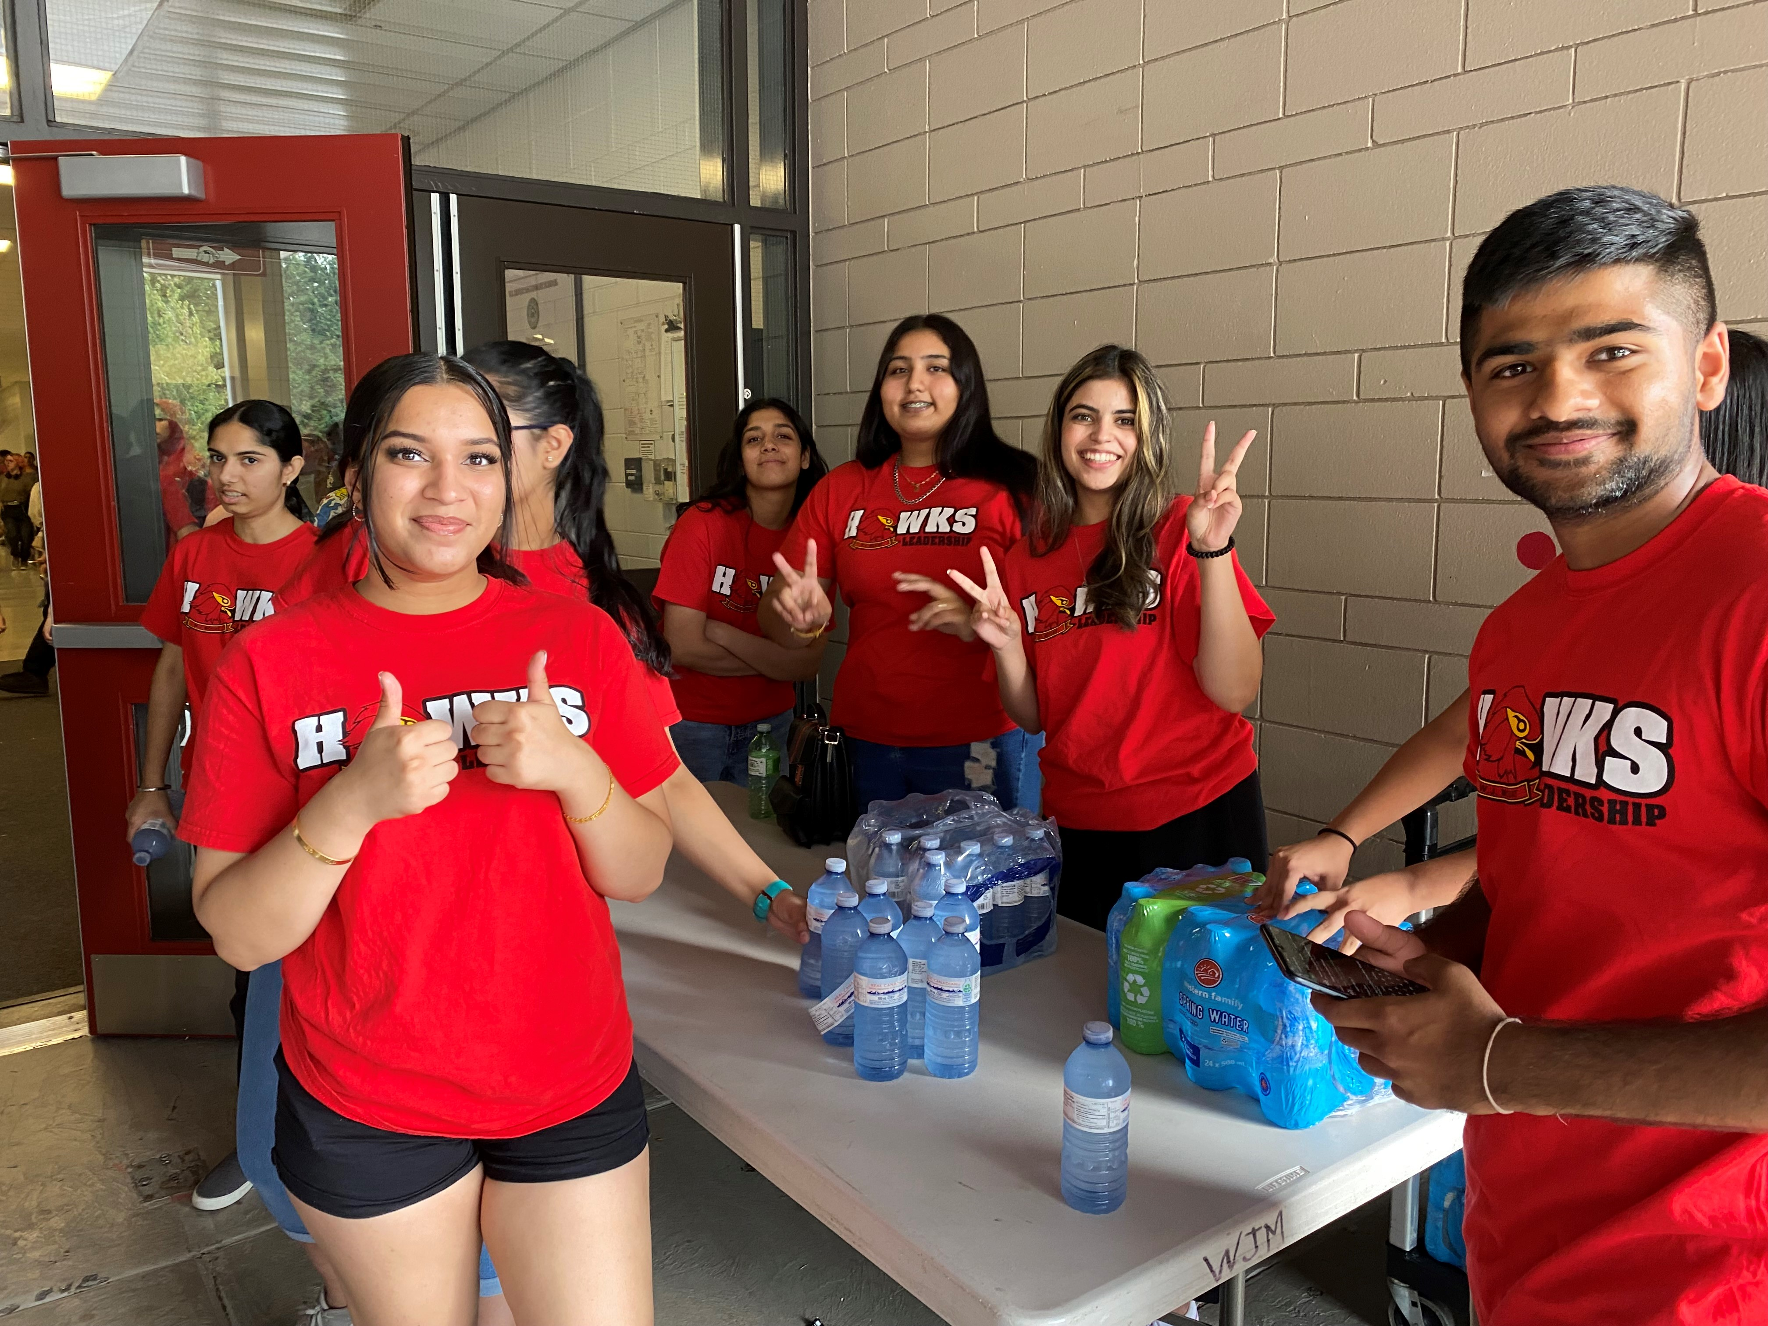
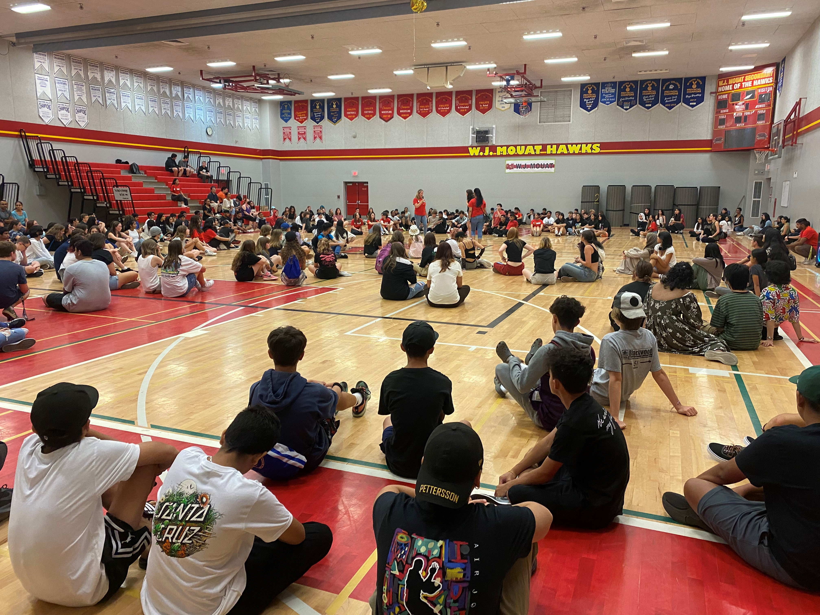
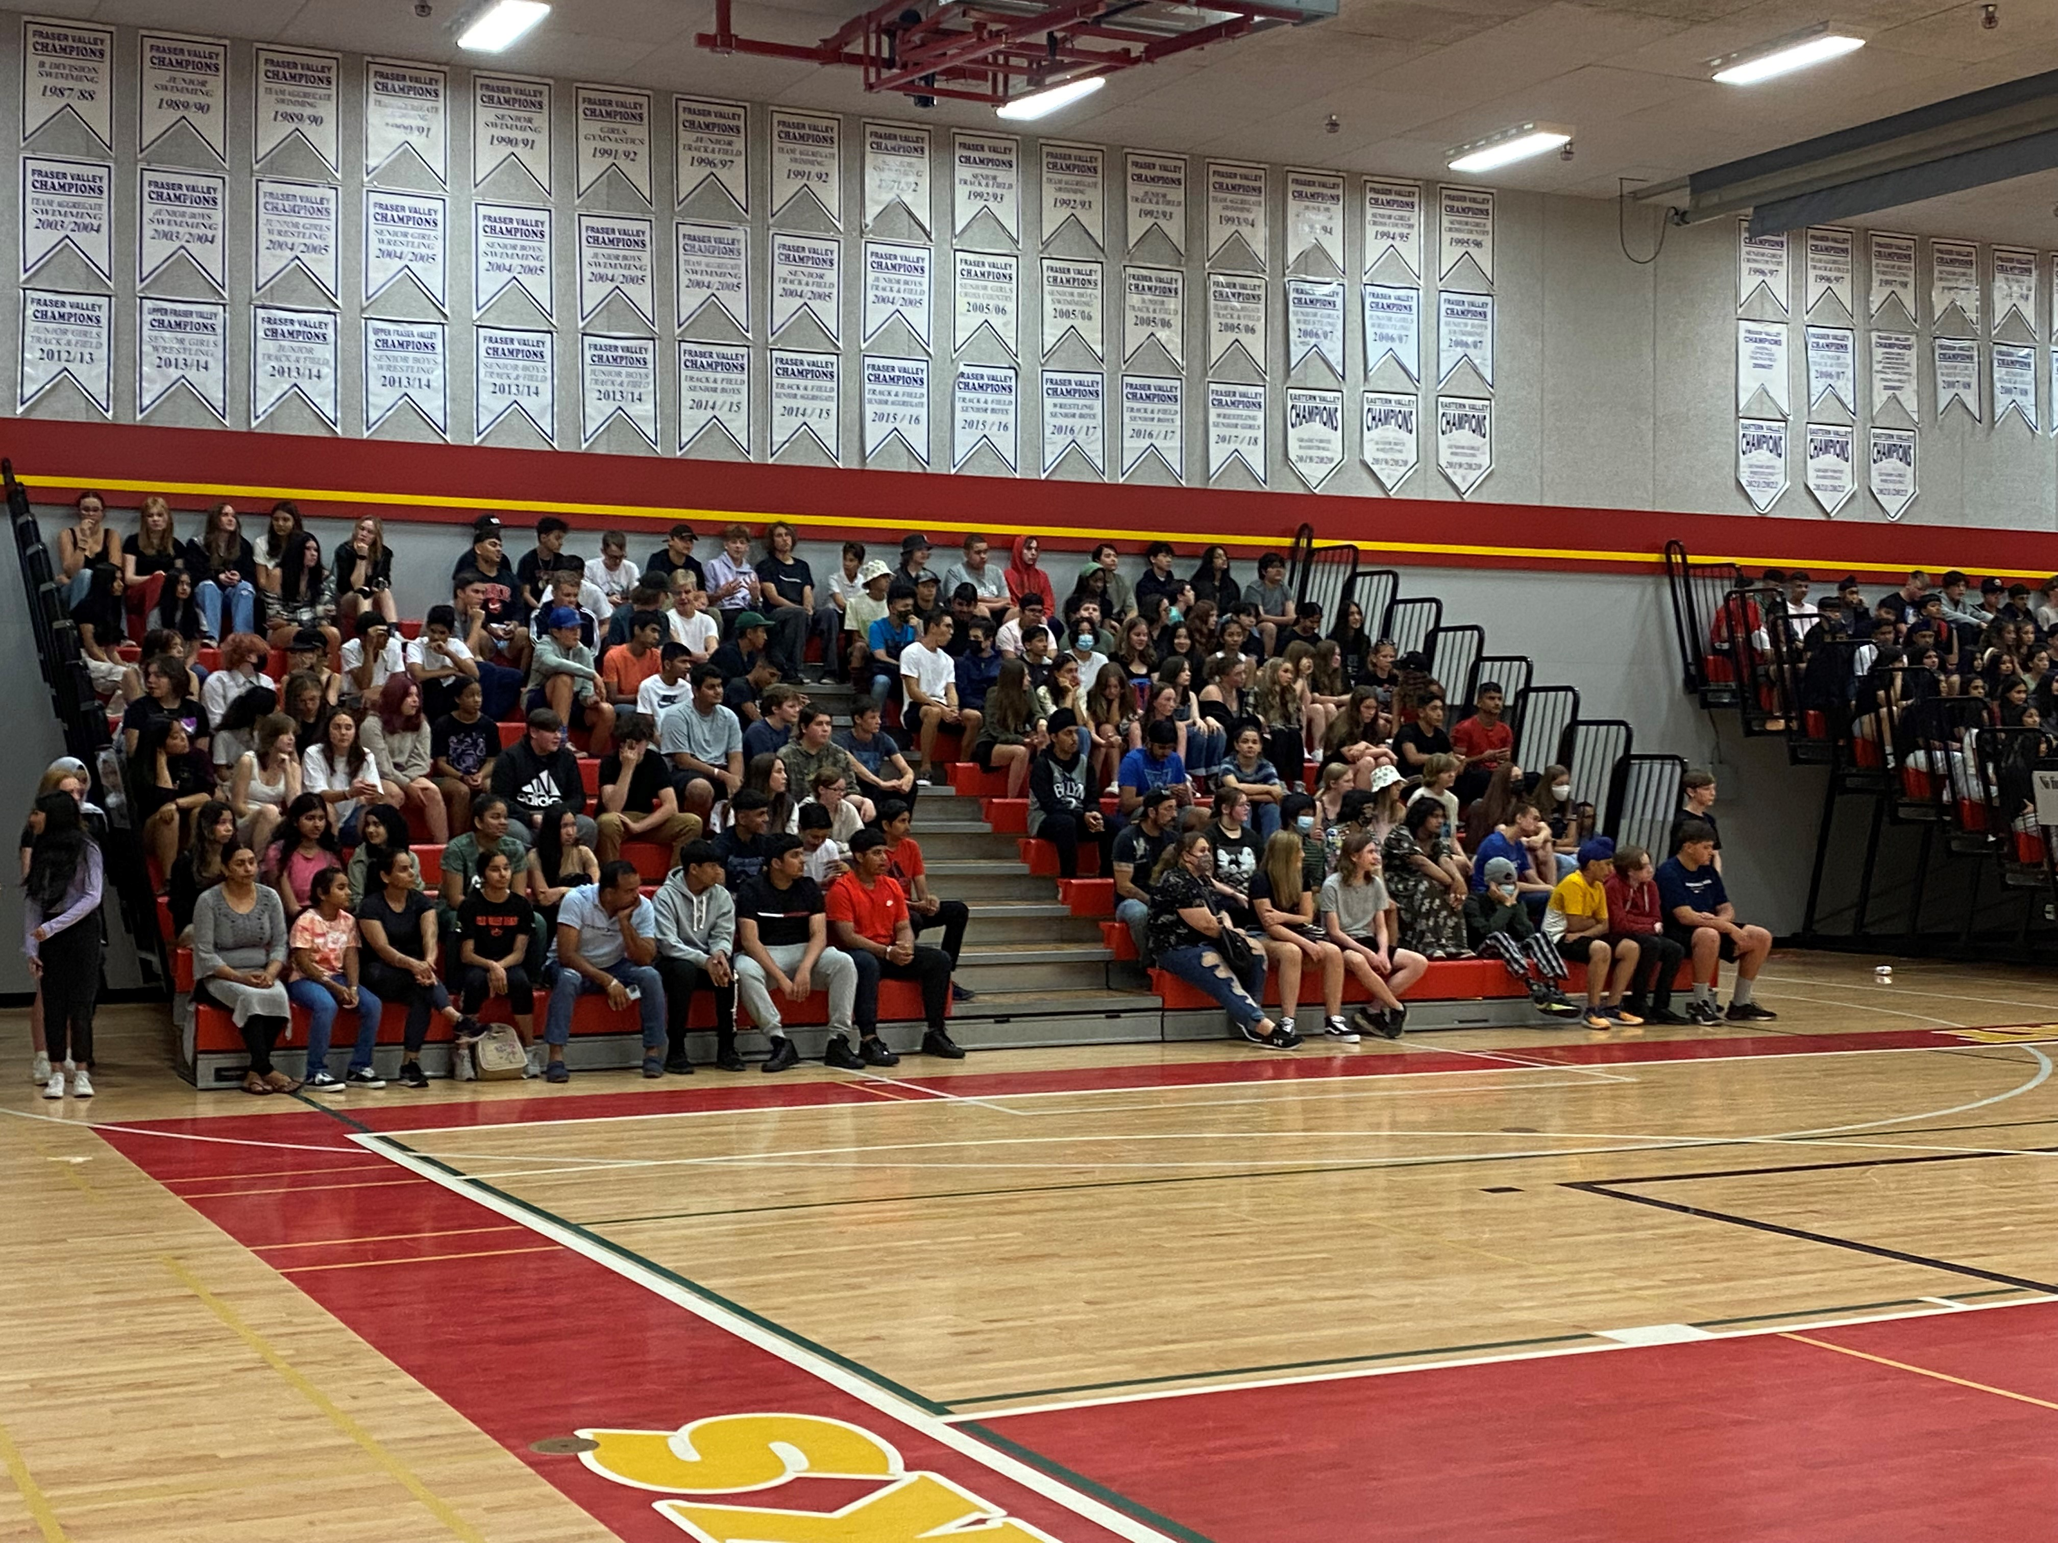
Welcome BBQ and Orientation
Wednesday, August 30th --Welcome BBQ and orientation for Grade 9s
BBQ/games/tour
10am start in the Mouat gymnasium
Locker sign up will occur after the orientation

Slide 7
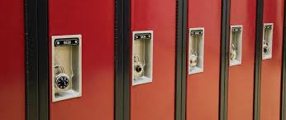
Lockers
Grade 9s wishing to have a locker must sign up for one with our office staff
This will occur on Wednesday August 30, after the Grade BBQ and orientation

Slide 8
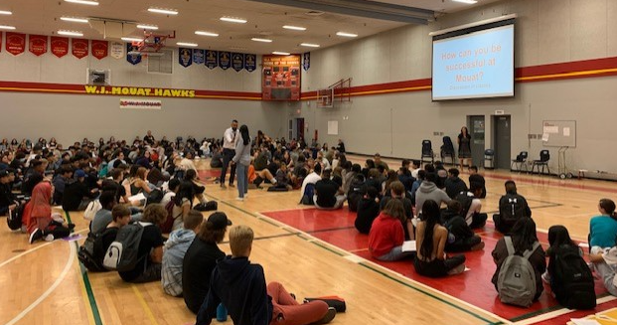
First Day of School
Tuesday, September 5th, 2023
Grade 9s Arrive and go to homeroom (homeroom lists will be on school walls/doors in front entry) | 8:00 to 8:20
Grade 9 Assembly | 8:20 to 9:55
Grade 9 Block Rotation – Block A | 10:00 to 10:10
Grade 9 Block Rotation – Block B | 10:15 to 10:25
Grade 9 Block Rotation – Block C | 10:30 to 10:40
Grade 9 Block Rotation – Block D | 10:45 to 10:55
Course changes will occur at 11am—students must line up outside the counselling center

Slide 9
First Week of School
Each day class will begin with a HOMEROOM Block at 8:10am.
On Tuesday, students will receive their timetable from their homeroom teachers.
During homeroom every day there will be information about the school (reading your timetable, understanding the bell schedule, accessing lockers, etc.)

Slide 10
Bell Schedule
Semester system (4 blocks per semester)
Tutorial and SLO days
Final schedule details will be on our website

Slide 11
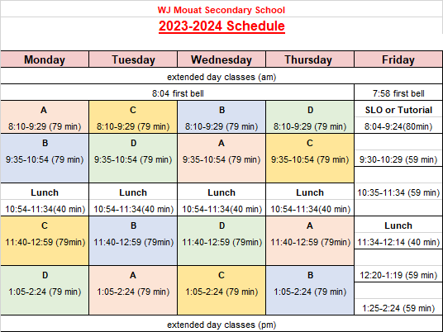
Bell Schedule

Slide 12
Grade 9 Course Load
Minimum of 8 courses. These include 5 mandatory classes: English 9, Math 9, Social Studies 9, Science 9, Physical and Health Education 9 and 3 elective courses.
Students who want to take advantage of the extended day class options will choose these in addition to their required 8 courses.
French Immersion students must take: Français langue 9, Mathématiques 9, Sciences humaines 9, Éducation physique 9, English 9, Science 9 and 2 electives.

Slide 13
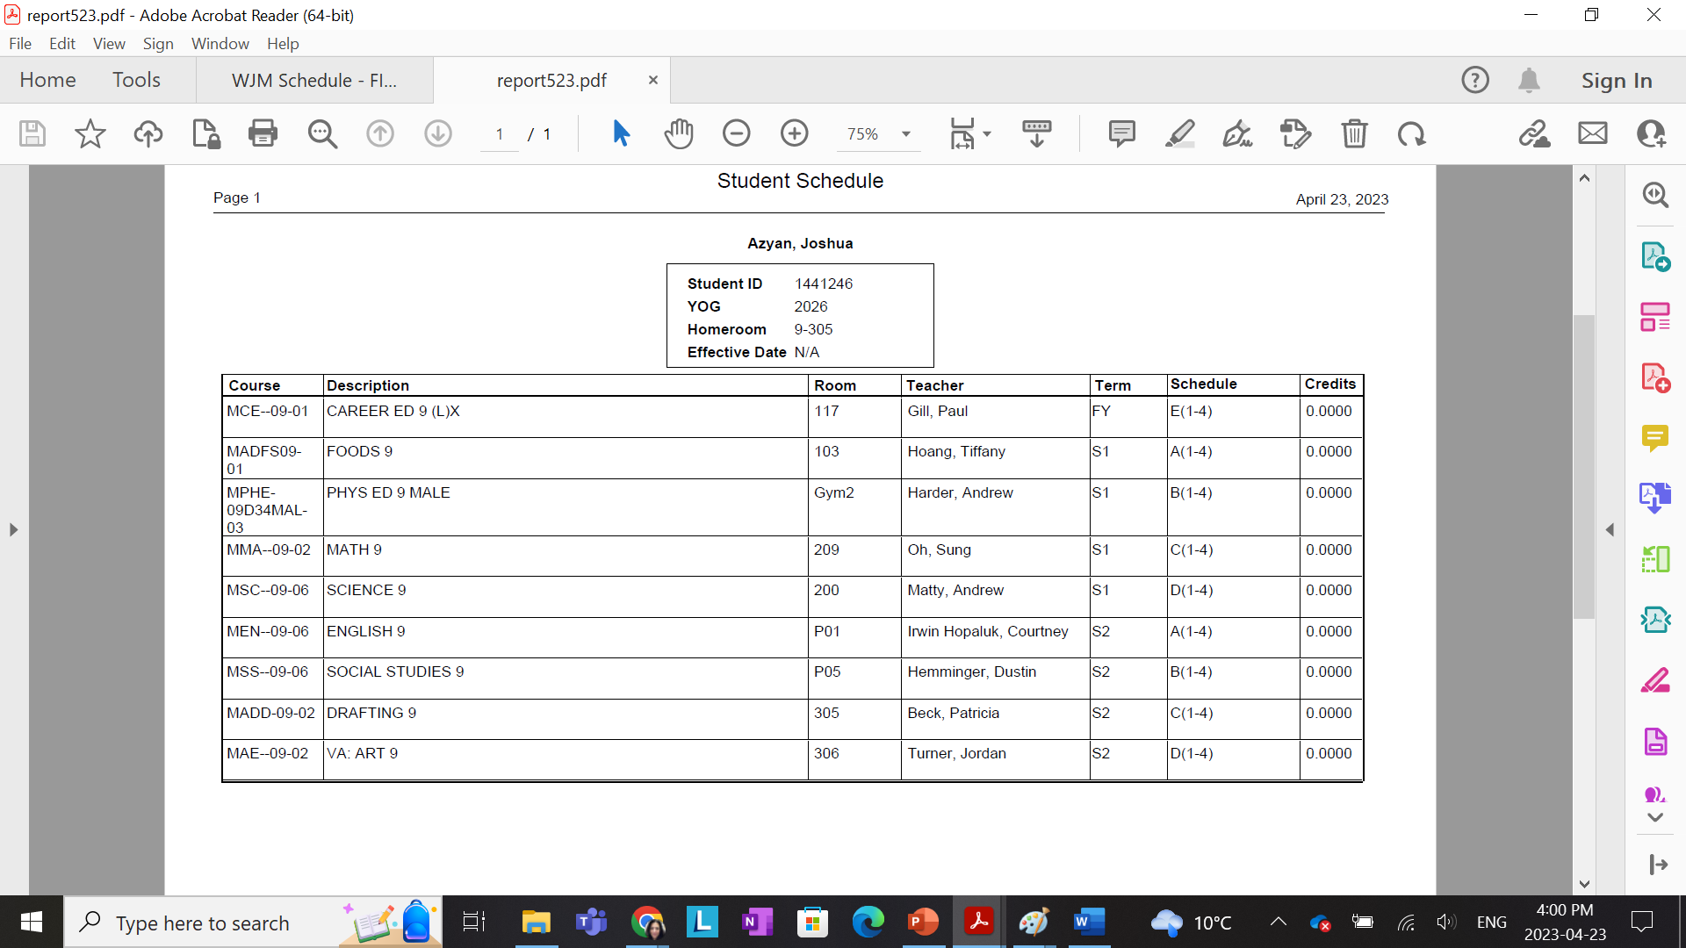
Time Table

Slide 14
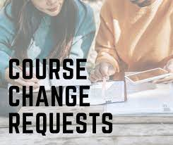
Course Changes
Course changes will occur on the first day of school right after the assembly and block rotation at 11am (outside the counselling center)
There will be limited course selection available (not about moving into classes with friends).

Slide 15
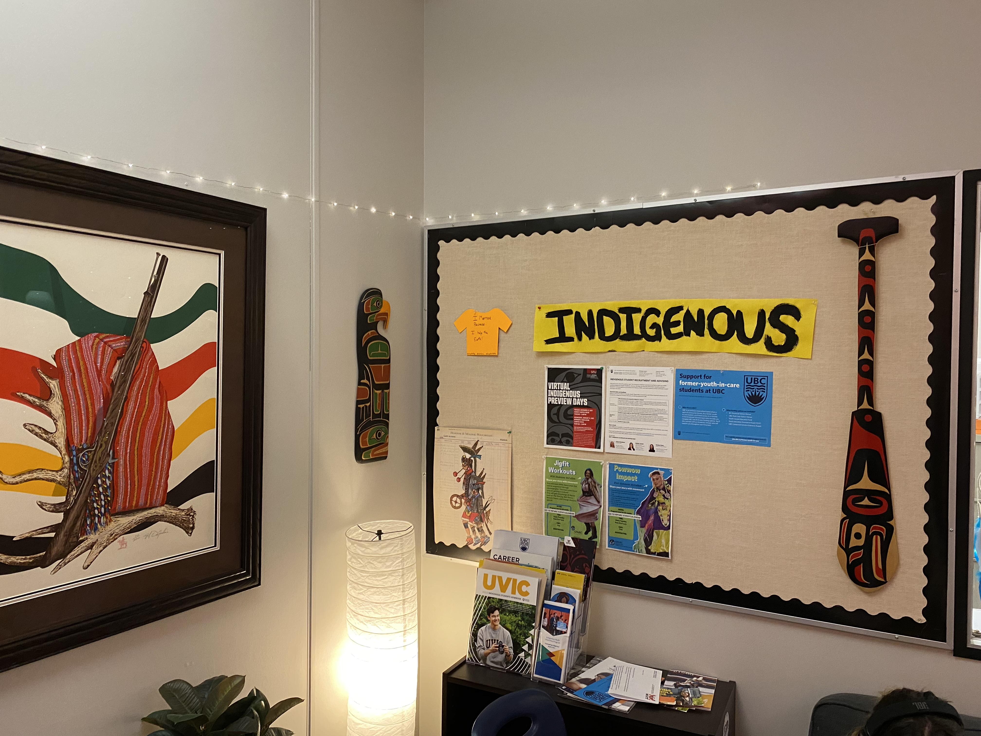
THRIVE
Indigenous Success Centre
Centrally located
HUB for all students

Slide 16
Learning Support Services
We see our support of your student as a partnership. If you have concerns or questions, PLEASE contact your child’s teacher/counsellor.
02 (Intensive Support)
Learning Support/assistance
ELL (English Language Learner)
We do have EA support in some classes.

Slide 17
BYOD
We have become a BYOD building (bring you own device).
We encourage students to have their own laptops that they bring to school when needed.
Several teachers operate entirely online.
Laptops are still available through our learning commons if students don’t have their own.

Slide 18
Dress Code
Students must wear clothing including both a shirt with pants or skirt, or the equivalent and shoes. Shirts and dresses must have fabric in the front and on the sides. Fabric covering all private parts must not be see through.
This is a place of business, and every workplace has a dress code. Look sharp and look smart. Leave a good impression on others.
No clothing displaying alcohol, drugs, and inappropriate content .You will be asked to change if necessary.
Hoods down.

Slide 19
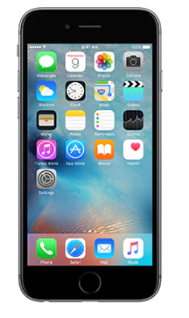
Cell Phones
Please do not use cell phones during instructional time unless permitted by your teacher.
If you need to be contacted, have your family call the office.

Slide 20
BUS Transportation
Please use the link below to register:
https://www.abbyschools.ca/student-transportation

Slide 21
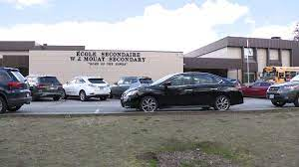
Parking / Traffic Loop
Please get dropped off and picked up in the front of the school or, preferably, along Mouat Drive.
(avoid stopping on the side of
Trethewey)
Give yourself enough time to get to class on time. It may take you longer to get to school due to traffic around the school.

Slide 22
Safety & Security – Theft
Leave valuables at home.
Keep locker combination a secret.
Use a lock for PE.
The school is not responsible for lost or stolen property. Please take care of your stuff!

Slide 23
Tips for Student Success
Attend all classes
Come to school on time
Be organized
Manage time
Complete all assignments
Get involved in extra-curricular clubs/sports
Ask for help from teachers/counsellors (self-advocate/take control)
Get enough sleep

Slide 24
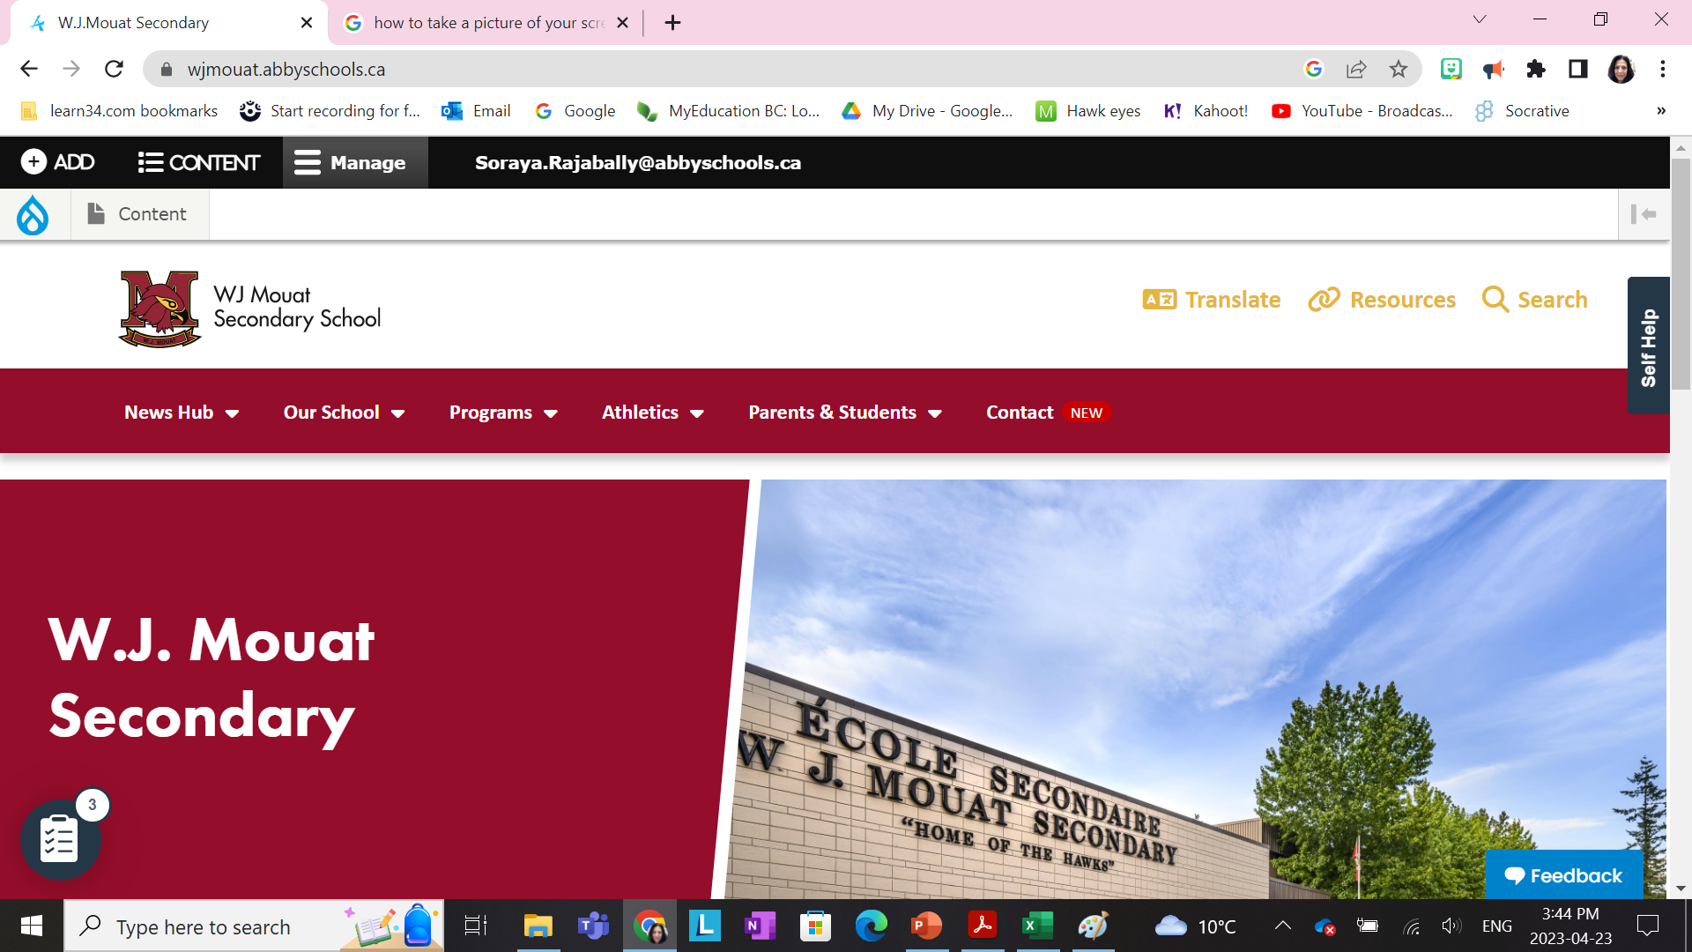
Communication
District App
W.J. Mouat Secondary School
wjmouat.abbyschools.ca
@wjmouat
Myschoolday App

Slide 25
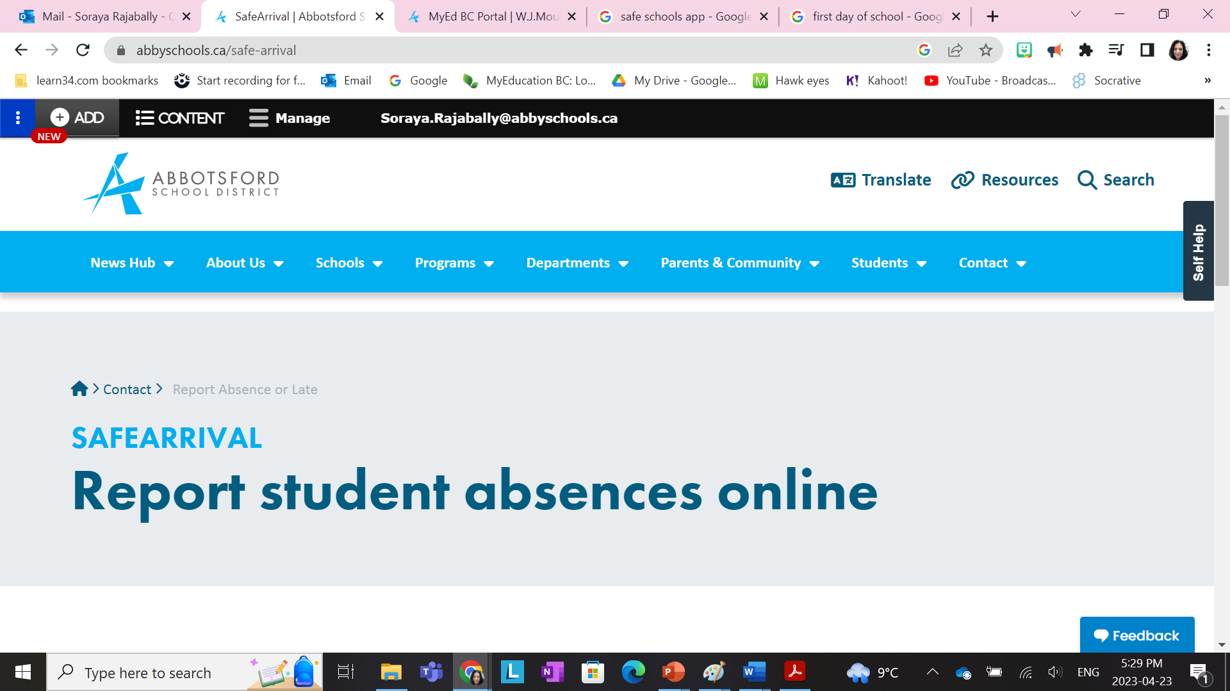
Reporting an Absence
1. SchoolMessenger App Using your mobile device, download and install the SchoolMessenger app from the Apple App Store or the Google Play Store. The first time you use the app, select Sign Up to create your account. Select Attendance then Report an Absence.
2. SafeArrival Website Using the SafeArrival website, go to: go.schoolmessenger.ca. The first time you use the website, select Sign Up to create your account. Select Attendance then Report an Absence.
3. Toll-Free Phonecall Call 1-844-487-3701 to report an absence using the automated phone system

Slide 26
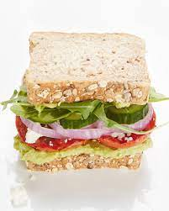
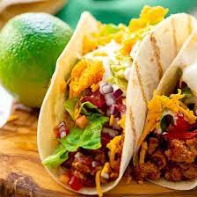
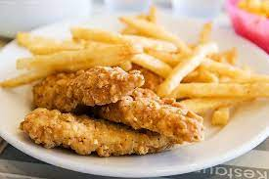
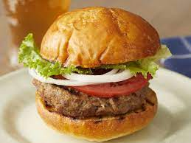
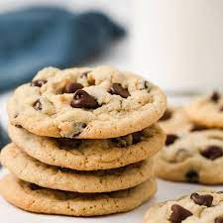
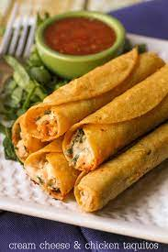
Food Options
Cafeteria
Daily entrees
The Hawk Café
Breakfast Club

Slide 27
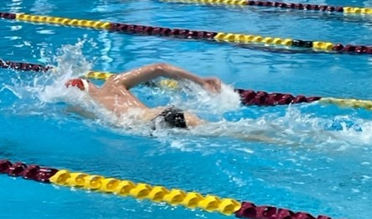
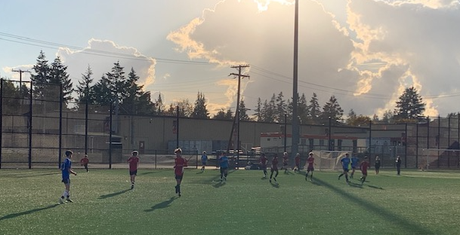
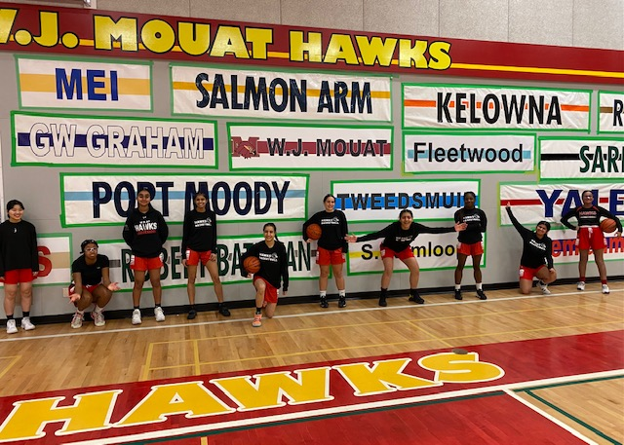
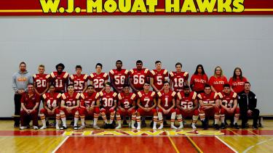
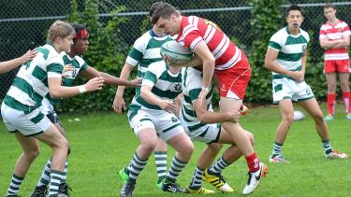
Mouat Athletics
WINTER
Basketball
Wrestling
FALL
Football
Volleyball
Cross Country
Swimming
Soccer
SPRING
Track and Field
Rugby
Soccer

Slide 28
Extra Curricular Clubs
Chess Club
Creative Writers Club
Culture Club
Dance Club
Games
Girls Club
GSA Club
Guitar Club
Ping Pong Club
Key Club
SIGN UP FOR A CLUB AT OUR CLUB FAIR-LUNCH TIME
Improv Club
Wellness Club
Knitting Club
Soccer Club
Green Team
Model UN
Drama Club
Benevolent Nerds Society (after school tutors)

Slide 29
Best Year Yet!
Grad 2027!

Slide 30
Q & A

